Slide 1
REACT ROUTING
By Mykhailo Torskyi

Slide 2
ROUTING
Routing is the process where user is directed to or rendered different pages based on user action/requests. In React, we can build Single Page Application (SPA) where web app loads a single page and dynamically updates that page as the user interacts with the web app.

Slide 3
INSTALLATION
React-router
React-router-dom
React-router-native

Slide 4
ROUTING COMPONENTS
There are three primary categories of components in React Router:
routers, like <BrowserRouter> and <HashRouter>
route matchers, like <Route> and <Switch>
navigation like <Link>, <NavLink>, and <Redirect>

Slide 5
ROUTERS
BrowserRouter uses regular URL paths, but they require your server to be configured correctly. Specifically, your web server needs to serve the same page at all URLs that are managed client-side by React Router.
HashRouter stores the current location in the hash portion of the URL, like http://example.com/#/your/page. Since the hash is never sent to the server, this means that no special server configuration is needed.

Slide 6
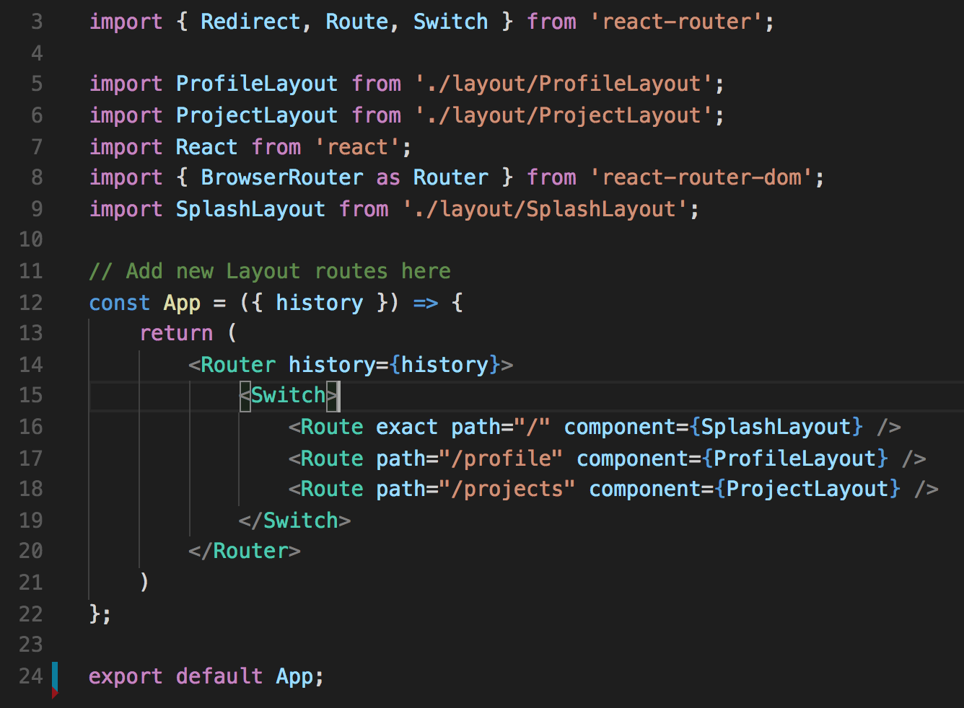
MATCHING
Switch
Route

Slide 7
NAVIGATION
Link component creates link in your application. Wherever you render a <Link>, an anchor (<a>) will be rendered in your HTML document.
NavLink is a special type of <Link> that can style itself as “active” when its to prop matches the current location.

Slide 8
LAZY-LOADING ROUTES
With React.lazy() and Suspense, it is now easy to perform route-based code-splitting without using any other external package. You can simply convert the route components of your app to lazy components and wrap all the routes with a Suspense component.

Slide 9
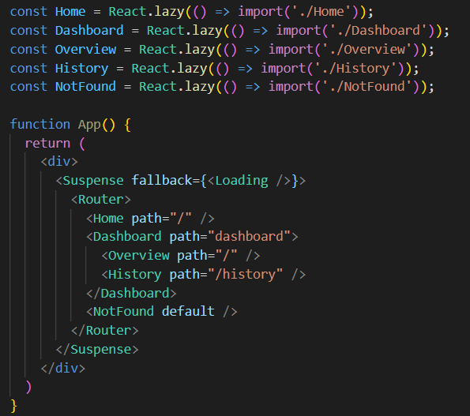

Slide 10


